Slide 1
Use of “DMOM CP Norm Generator V1.6”
Questions or issues can be sent to David Schreurs at schreurd@uwm.edu/dgschreurs@yahoo.com

Slide 2
Overview
This app is designed to take questions from two preexisting exams and predict the norms for an untested exam built from a subset of those questions. If student performance is available on the new exam, it can also be fed into the predicted norms.
This is completed using a combination of 2-PL, NRM, and GPCM IRT models. In short, this is completed by first using the Modeled Open Maxima process to assign partial credit to each response option (MOM). These partial credit options are then used with GCPM to generate factor scores which are fed into Dichotomous IRT parameters and scores are extracted using Credit Probability (D___ CP).

Slide 3
Table of Contents
Preparing Data
Running the Script
Interpreting Exported Results

Slide 4
Preparing Data
Templates with fictitious data for each of these files is available on my github page.
https://github.com/clapsback/DMOM-CP-Norm-Generator

Slide 5
Preparing Data
Be default R will import the necessary files as long as they are saved in the same folder as where the script is saved and have the following names:
Old E1.xlsx
Old E2.xlsx
Old E1 Key.xlsx
Old E2 Key.xlsx
Question Alignment.xlsx
In addition, this file will be imported if “NewExamScores=TRUE” under “User Input”
New E Scores.xlsx
In addition, these files will be imported if “RaterScores=TRUE” under “User Input”
Old E1 Removed Questions PC.xlsx
Old E2 Removed Questions PC.xlsx

Slide 6
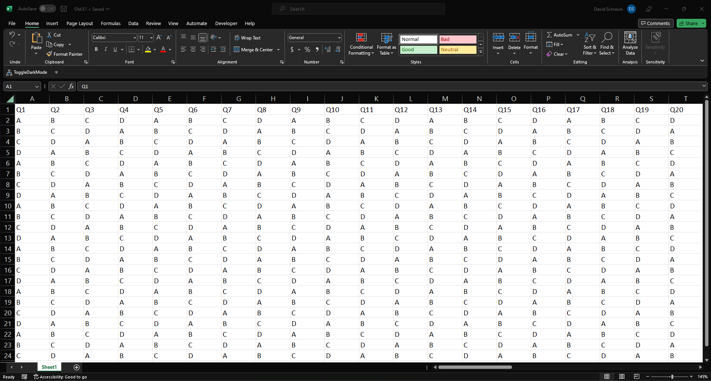
Preparing Data
Old E1.xlsx
Letter responses (A/B/C/D) for each question on the first old exam. Row 1 is the column heading specifying the question number. The heading should match the question identifier used in “Old E1 Key.xlsx” and “Question Alignment.xlsx”. Any cells that do not contain “A”, “B”, “C”, or “D” will be treated as missing responses. Lowercase letters will be accepted and capitalized.
Sample Data

Slide 7
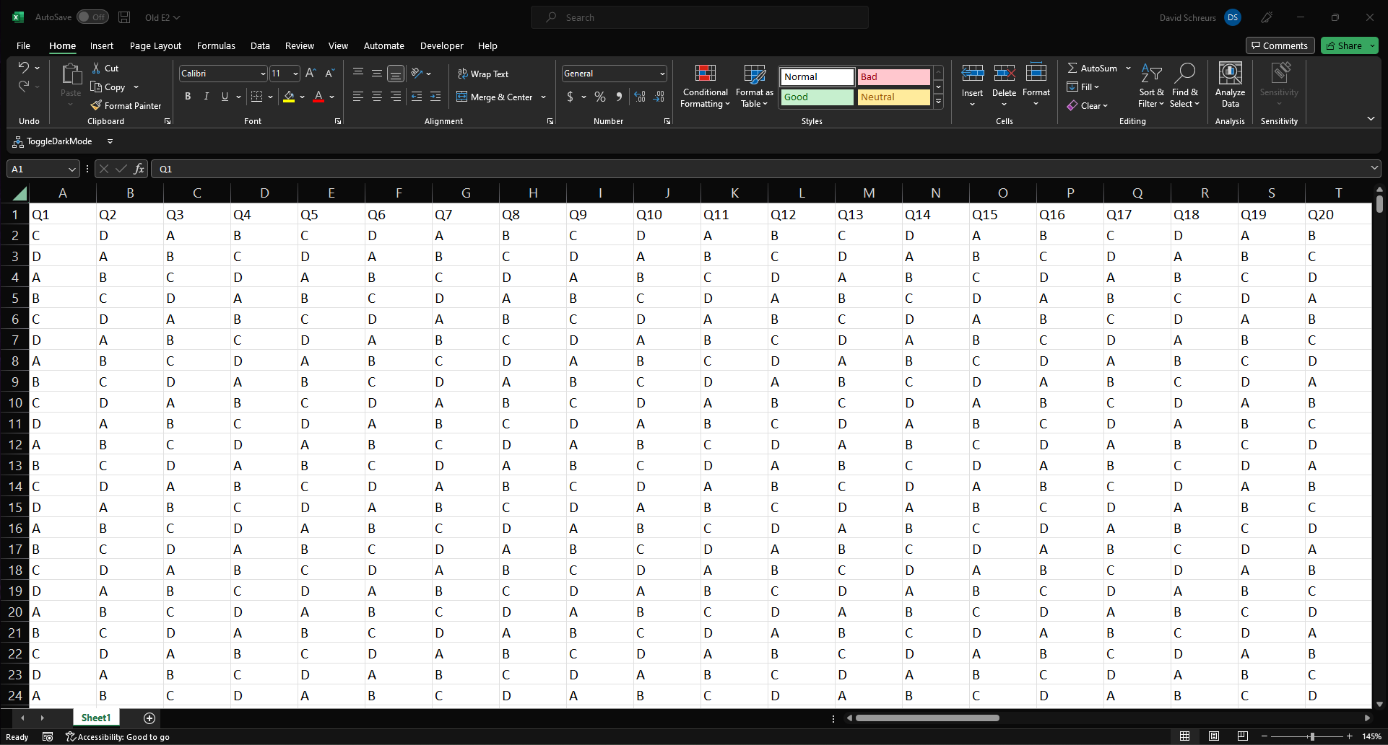
Preparing Data
Old E2.xlsx
Letter responses (A/B/C/D) for each question on the second old exam. Row 1 is the column heading specifying the question number. The heading should match the question identifier used in “Old E2 Key.xlsx” and “Question Alignment.xlsx”. Any cells that do not contain “A”, “B”, “C”, or “D” will be treated as missing responses. Lowercase letters will be accepted and capitalized.
Sample Data

Slide 8
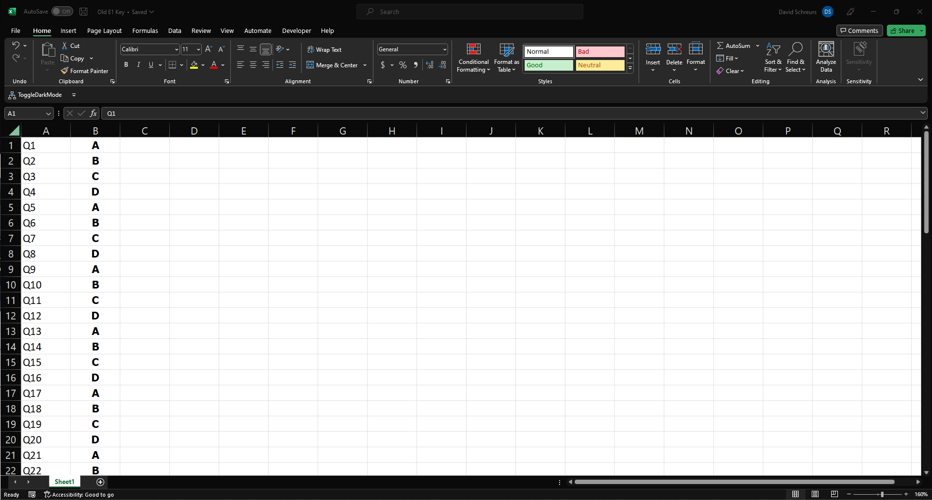
Preparing Data
Sample Data
Old E1 Key.xlsx
Column A is composed of the question identifiers which need to match those used in “Old E1.xlsx”. Column B is the correct letter response (A/B/C/D) for each question on old exam 1.

Slide 9
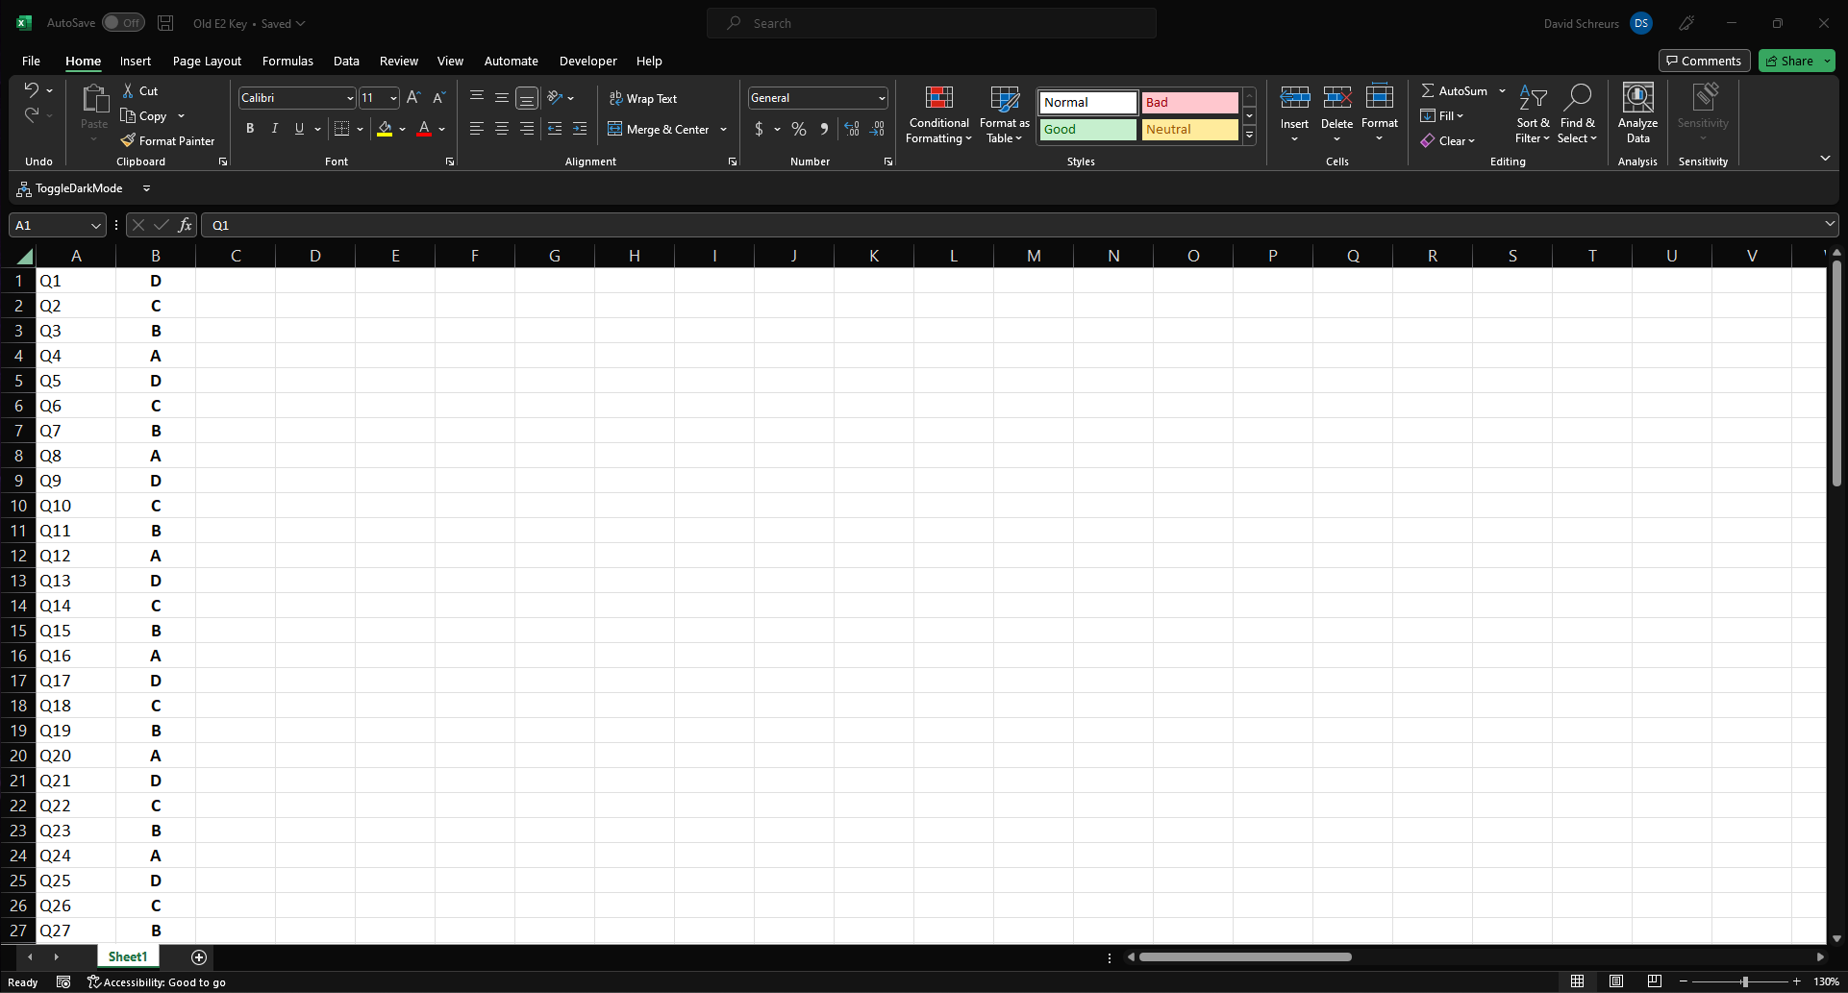
Preparing Data
Sample Data
Old E2 Key.xlsx
Column A is composed of the question identifiers which need to match those used in “Old E2.xlsx”. Column B is the correct letter response (A/B/C/D) for each question on old exam 2.

Slide 10
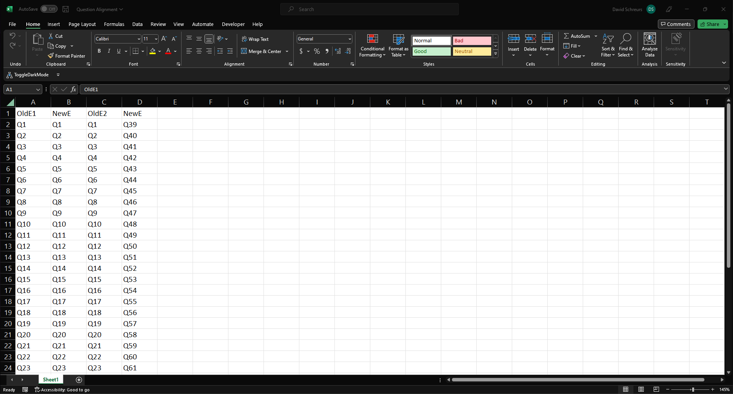
Preparing Data
Sample Data
Question Alignment.xlsx
This document specifies which questions from the old exams you wish to include on the new exam. The question numbers in column A must match the question heading specified in “Old E1.xlsx”. The question numbers in column C must match the question heading specified in “Old E2.xlsx”.

Slide 11
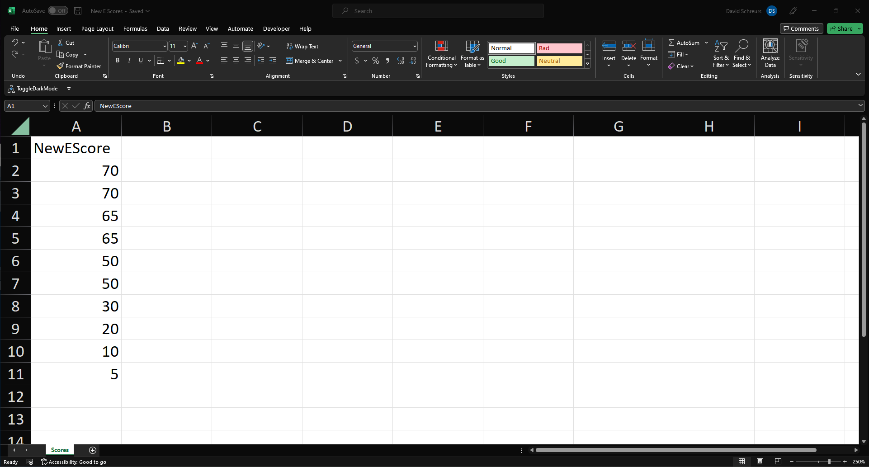
Preparing Data (If NewExamScores=TRUE)
Sample Data
New E Scores.xlsx
Row 1 is expected to be the column heading. All other rows in column A contain the number of questions each student answered correctly on the new exam.

Slide 12
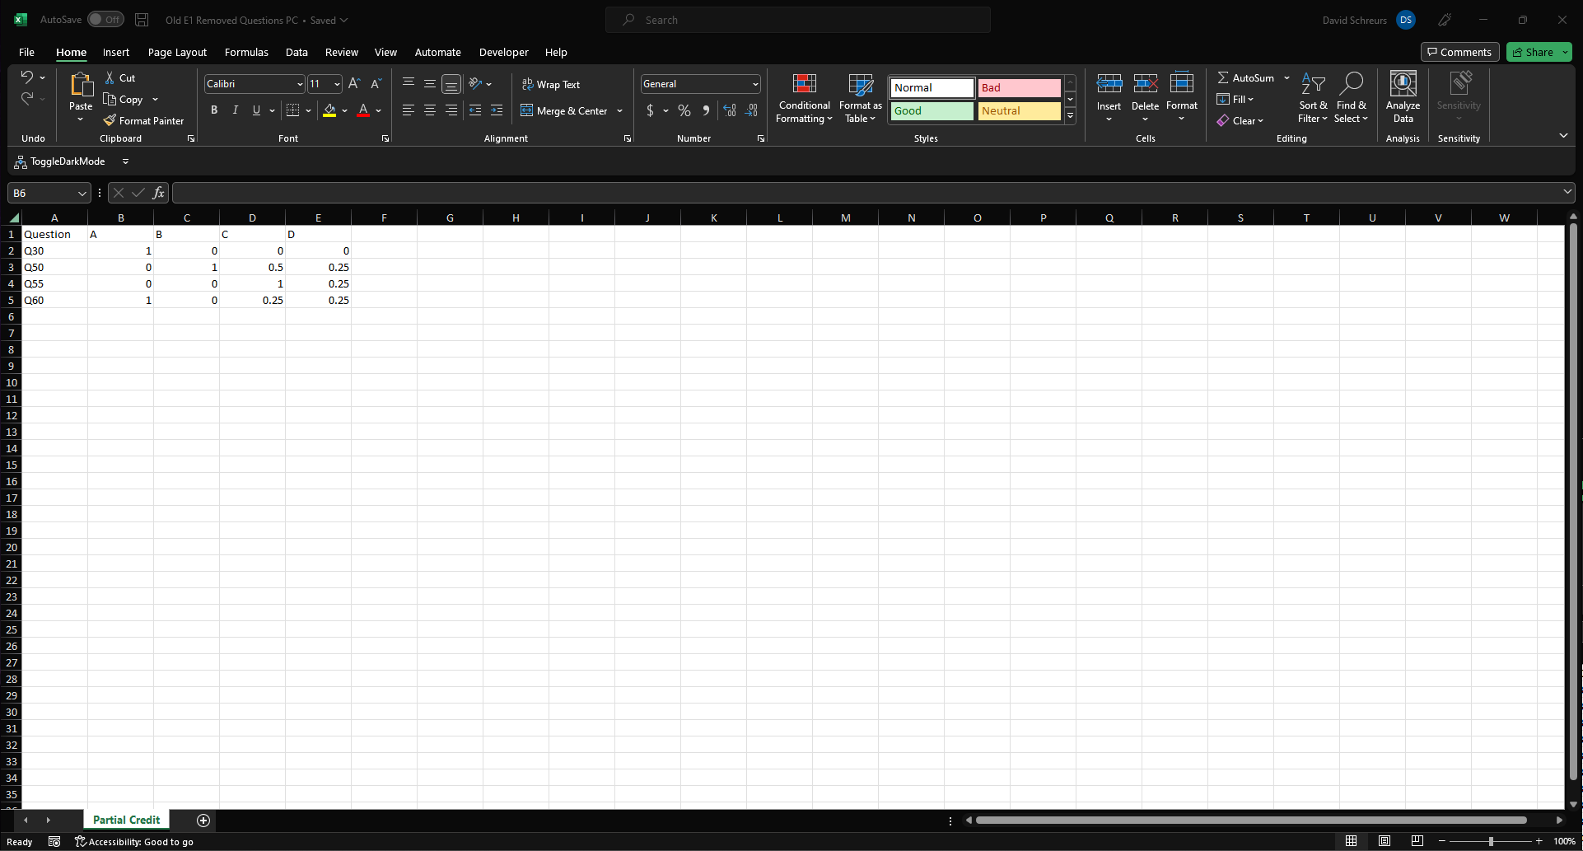
Preparing Data (If RaterScores=TRUE)
Old E1 Removed Questions PC.xlsx
The question numbers in column A must match the question heading specified in “Old E1.xlsx”. As indicated by the headings, the second column is the credit which should be assigned to option A, the third column is the credit which should be assigned to option B, the fourth column is the credit which should be assigned to option C, and the fifth column is the credit which should be assigned to option D. Credit options must be 0, 0.25, 0.33, 0.5 or 1.
Sample Data

Slide 13
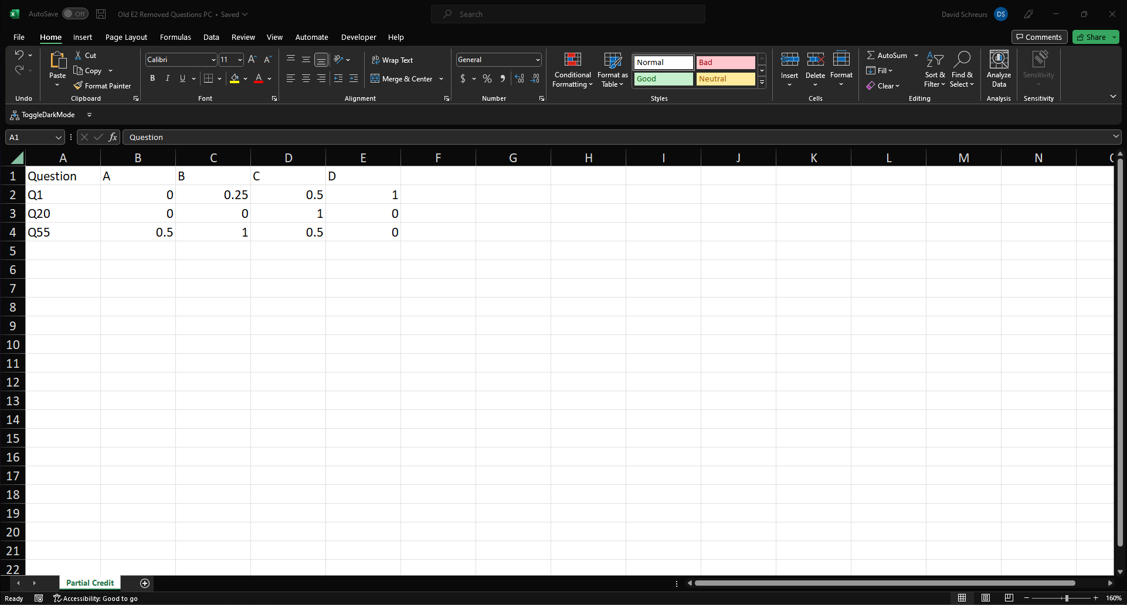
Preparing Data (If RaterScores=TRUE)
Old E2 Removed Questions PC.xlsx
The question numbers in column A must match the question heading specified in “Old E2.xlsx”. As indicated by the headings, the second column is the credit which should be assigned to option A, the third column is the credit which should be assigned to option B, the fourth column is the credit which should be assigned to option C, and the fifth column is the credit which should be assigned to option D. Credit options must be 0, 0.25, 0.33, 0.5 or 1.
Sample Data

Slide 14
Running the Script
If this is the first time running the script on this computer, install the necessary packages by running these lines of code in the R console
install.packages("ltm")
install.packages("plyr")
install.packages("readxl")
install.packages("openxlsx")
install.packages("irtoys")
install.packages("tidyr")
install.packages("geiger")
install.packages("caTools")
install.packages("lattice")
install.packages("stats4")
install.packages("mirt")
install.packages("ggplot2")
install.packages("cowplot")
install.packages("psych")
install.packages("av")
install.packages("devtools")
library(devtools)
install_github("manuelreif/mcIRT", ref="master")

Slide 15
Running the Script
Assuming the excel files have been named, formatted, and saved correctly in the same directory that the R script is saved in, the code is ready to be run.
Many aspects of the script were designed to be easily altered. These can be found under the “User Input” section and each option is explained through code comments.
Ctrl + Enter can be used to run each line of code
Ctrl + A (to select all), followed by Ctrl + Enter can be used to run the entire script

Slide 16
Running the Script
After the complete code has been run, a new folder with results will be created in the same directory as where the R script is saved. This folder will be named “DMOM CP Norm”.

Slide 17
Interpreting Exported Results
Within the “DMOM CP Norm” folder, the most important fille will be a document named “Results.xlsx”. This document contains the following tabs:
Old E1 Removed Questions
Old E2 Removed Questions
Old E1 ICCs
Old E2 ICCs
Old E1 MOM Partial Credit
Old E2 MOM Partial Credit
Norm of Actual New Exam Scores
Only if NewExamScores=TRUE and sample size exceeds NewExamMinSampleSize
New E Difference in Percentile
Only if NewExamScores=TRUE and sample size exceeds NewExamMinSampleSize
Predicted New E Norms
Script Info

Slide 18
Interpreting Exported Results
Old E1 Removed Questions
Questions from old exam 1 which were removed as they were below the discrimination threshold (DiscThresh under User Input). As these questions did not perform well enough for partial credit to be predicted, they are either scored dichotomously (if RaterScores=FALSE) or using the values imported in “Old E1 Removed Questions PC.xlsx” (if RaterScores=TRUE).

Slide 19
Interpreting Exported Results
Old E2 Removed Questions
Questions from old exam 2 which were removed as they were below the discrimination threshold (DiscThresh under User Input). As these questions did not perform well enough for partial credit to be predicted, they are either scored dichotomously (if RaterScores=FALSE) or using the values imported in “Old E2 Removed Questions PC.xlsx” (if RaterScores=TRUE).

Slide 20
Interpreting Exported Results
Old E1 ICCs
Item characteristic curves (ICCs) for each question above the discrimination threshold on old exam 1. These curves are based on the NLM (2-PL + NRM) and show the probability of each ability student selecting each response. It is through the maxima of these curves that partial credit is assigned to each response.

Slide 21
Interpreting Exported Results
Old E2 ICCs
Item characteristic curves (ICCs) for each question above the discrimination threshold on old exam 2. These curves are based on the NLM (2-PL + NRM) and show the probability of each ability student selecting each response. It is through the maxima of these curves that partial credit is assigned to each response.

Slide 22
Interpreting Exported Results
Old E1 MOM Partial Credit
This tab contains the model-determined credit to assign to each response option on exam 1 which was not removed due to low discrimination. These values could be 0, 0.25, 0.33, 0.5, or 1.

Slide 23
Interpreting Exported Results
Old E2 MOM Partial Credit
This tab contains the model-determined credit to assign to each response option on exam 2 which was not removed due to low discrimination. These values could be 0, 0.25, 0.33, 0.5, or 1.

Slide 24
Interpreting Exported Results
Norm of Actual New Exam Scores
This tab is only created if student scores on the new exam were used (if NewExamScores=TRUE and sample size exceeds NewExamMinSampleSize). This tab only contains the norm plot for the scores uploaded in “New E Scores”. This should be used as a tool to determine if the new exam data appears normal and sufficient for feeding into the modeled norm.

Slide 25
Interpreting Exported Results
New E Difference in Percentile
This tab is only created if student scores on the new exam were used (if NewExamScores=TRUE and sample size exceeds NewExamMinSampleSize). These scores are then used to replace the modeled data until all modeled data has been replaced (new data is then simply added in). Column A shows the number of new exam scores used and column B contains the area under the curve created by subtracting the fully modeled percentile by the model with actual student performance on the new exam percentile. The curves showing the difference in percentile (which is summarized by this area under the curve) can be found exported in the “Percentile Plots” folder as well as the “Percentile Plots.mp4”. Broadly speaking, these values indicate the magnitude of the norm change through the addition of real data.

Slide 26
Interpreting Exported Results
Predicted New E Norms
The tab contains
Column A: The scores which are predicted to occur on the new test
Column B: For each score, the percent of students who are predicted to receive that score
Column C: For each score, the predicted percentile
Column E-N: A norm plot based on the percentages in Column B
If no real data used or if real data was substituted in using Random Replacement (as Norm Averaging merges norms instead of scores these values are not possible)
Column P-Q: Stats pertaining to the results
Column S: Scores for each of the students (ordered from highest to lowest)
Column T: Indicator if the scores are predicted by the model (0) or are from real students (1)

Slide 27
Interpreting Exported Results
Script Info
The tab contains
Row 1: A brief explanation of what method was used to predict the new exam norms
Either
Modeled results only
Model and actual data combined through norm averaging
Model and actual data combined through random replacement
Row 2-11: All parameters set in “User Input” to allow for reproducible results

